Slide 2


Slide 3


Slide 4


X

Slide 5


Joint Distributions
Covariance and Correlation
X

Slide 6
Joint Distributions
When studying mathematics for data science, we’re often interested in the relationships between two data dimensions.
Data-driven organizations often need to understand interactions between two data features in order to make decisions about features that are linked.
X

Slide 7
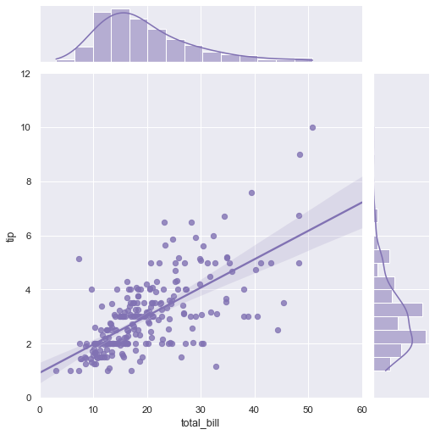
Joint Distributions
Joint Distributions allow us to mathematically quantify the relationship between two distributions of data.
X

Slide 8
Joint Distributions
This section of the course will focus on two specific properties of joint distributions: covariance and correlation.
In general these terms measure how much two data features move together.
X

Slide 9
Joint Distributions
It is a common task to try to understand correlations between two data variables.
For example, most businesses keep track of how correlated price changes are with overall sale revenues.
X

Slide 10
Joint Distributions
When thinking about covariance and correlation, we’re typically discussing it in terms of two data features. Commonly notated as x and y , since if one were to plot these features you could plot one on the x-axis and the other on the y-axis.
X

Slide 11
Joint Distributions
For example, looking back at our tips dataset:
X

Slide 12
Joint Distributions
Before we do a deep dive into the details of covariance and correlation, let’s do a high level overview of these concepts.
We’ll also understand the motivation behind understanding these concepts in the context of using data science for business.
X

Slide 13
Joint Distributions
Covariance
X

Slide 14
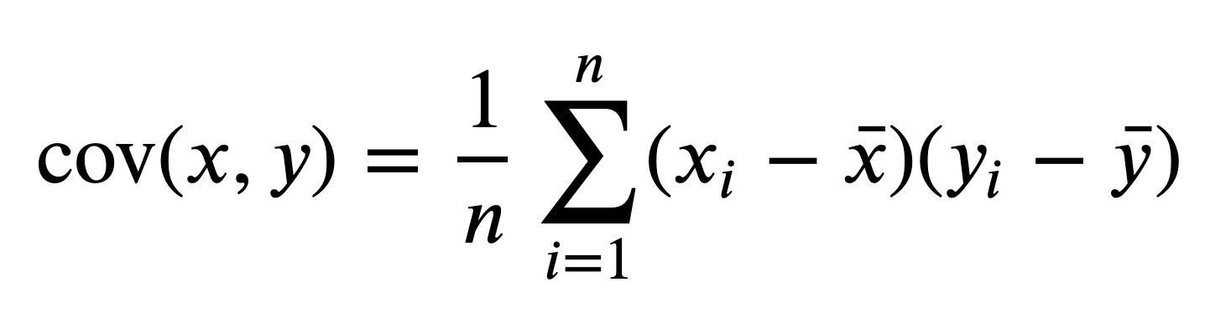
Joint Distributions
Covariance
The formula for covariance is:
X

Slide 15
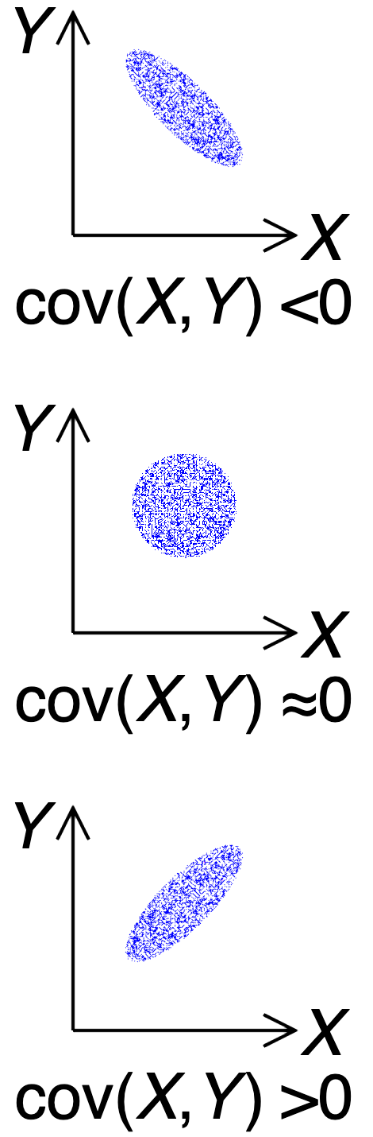
Joint Distributions
Covariance
The formula for covariance is:
X

Slide 16
Joint Distributions
Covariance
The formula for covariance is:
Quick Note!
You will sometimes see this as n-1 and other times as n. n-1 is for a sample covariance while n is for a population covariance.
X

Slide 17
Joint Distributions
Covariance
The formula for covariance is:
The covariance of the data feature x with the data feature y.
For example: cov(bill,tip).
X

Slide 18
Joint Distributions
Covariance
The formula for covariance is:
Divide by n, where n is the number of data points. Note how this implies x and y have matching length (same number of data points).
X

Slide 19
Joint Distributions
Covariance
The formula for covariance is:
You should notice this feels a lot like the same calculation for an average!
X

Slide 20
Joint Distributions
Covariance
The formula for covariance is:
This is sum notation. It states to take the sum of the calculation on the right for every point in x and y, starting with x₁ and y₁, then x₂ and y₂, and so on for all x_{i} and y_{i} until you reach the last points at n.
X

Slide 21
Joint Distributions
Covariance
The formula for covariance is:
This is an interesting calculation. It’s the difference between each point and the mean value for that data series. Then you multiply that calculation between x and y together.
X

Slide 22
Joint Distributions
Covariance
The formula for covariance is:
This entire formula should feel familiar if you’ve already seen the formula for variance…
X

Slide 23
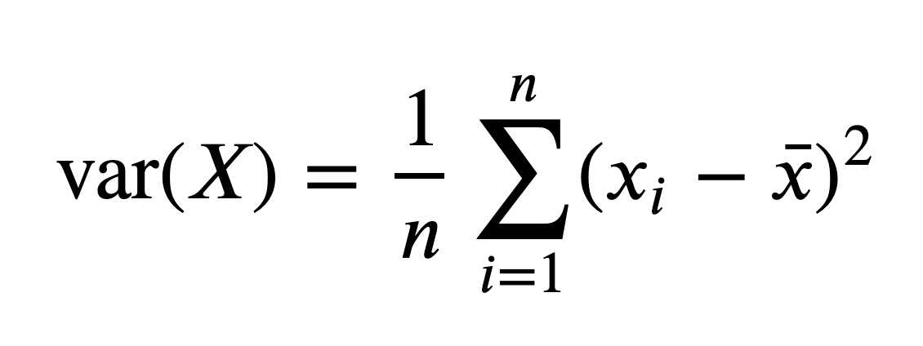
Joint Distributions
Covariance
The formula for covariance is:
Notice how it’s actually variance, but with another data feature!
X

Slide 24
Joint Distributions
Covariance
The formula for covariance is:
Thus the name covariance!
X

Slide 25
Joint Distributions
Covariance
Now that we’ve briefly explored the formula, what information does covariance actually report back to us?
X

Slide 26
Joint Distributions
Covariance
Recall that variance reports back the squared difference of the average value from the mean.
X

Slide 27
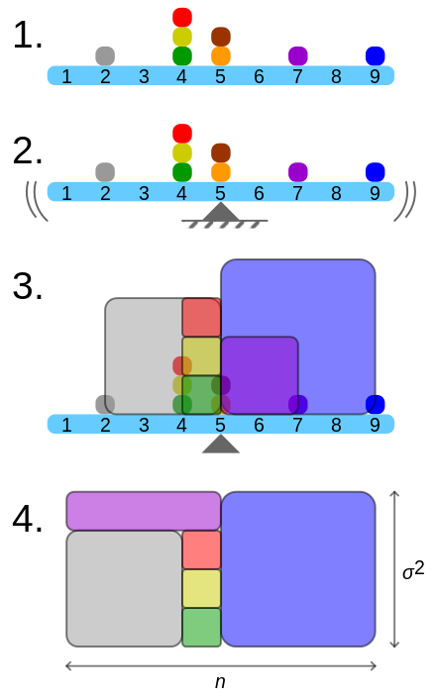
Joint Distributions
Covariance
Recall that variance reports back the squared difference of the average value from the mean.
X

Slide 28
Joint Distributions
Covariance
Recall that variance reports back the squared difference of the average value from the mean.
X

Slide 29
Joint Distributions
Covariance
Recall that variance reports back the squared difference of the average value from the mean.
X

Slide 30
Joint Distributions
Covariance
Recall that variance reports back the squared difference of the average value from the mean.
X

Slide 31
Joint Distributions
Covariance
This same concept of area can be applied with covariance, it’s just now in two dimensions X and Y!
X

Slide 32
Joint Distributions
Covariance
This same concept of area can be applied with covariance, it’s just now in two dimensions X and Y!
X

Slide 33
Joint Distributions
Covariance
Start with the mean x and mean y values on your plot.
Y
X
X

Slide 34
Joint Distributions
Covariance
Start with the mean x and mean y values on your plot.
Y
X
X

Slide 35
Joint Distributions
Covariance
Then plot a point (x_{i},y_{i})
Y
X
X

Slide 36
Joint Distributions
Covariance
Notice how (x_{i}-x,y_{i}-y) is the calculation for the area of a square! Just as before, but now in 2 dimensions.
Y
X
X

Slide 37
Joint Distributions
Covariance
Next, we simply look at the slope between the two lines, negative vs. positive.
Y
X
X

Slide 38
Joint Distributions
Covariance
If it is negative slope, like in this example, then we treat this total area as a negative covariance.
Y
X
X

Slide 39
Joint Distributions
Covariance
For example, in this point, we can see the the slope between the point (x_{i},y_{i}) and the means is positive.
Y
X
X

Slide 40
Joint Distributions
Covariance
Which means we have positive covariance.
Y
X
X

Slide 41
Joint Distributions
Covariance
We now begin to sum these area values to determine the covariance between the series.
Y
X
X

Slide 42
Joint Distributions
Covariance
Note how the formula indicates we will do this for all x and y points.
Y
X
X

Slide 43
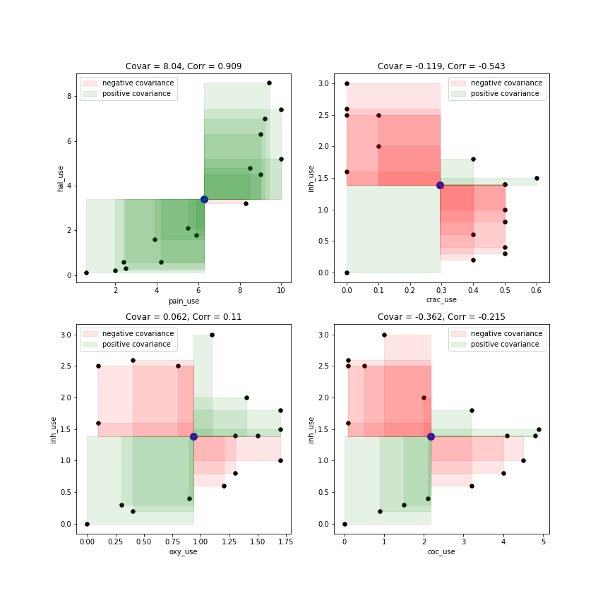
Joint Distributions
Covariance
Here we see a set of series with positive covariance. Notice how a trend line would have positive slope here.
X

Slide 44
Joint Distributions
Covariance
Here we see a set of series with negative covariance. Notice how a trend line would have a negative slope here.
X

Slide 45
Joint Distributions
Covariance
Finally here are two data series with almost zero covariance. Notice how the positive and negative areas balance out.
X

Slide 46
Joint Distributions
Covariance
We’ll take a deeper dive into covariance later on in this section, but use this visualization of positive and negative areas to give yourself an intuition of how covariance is calculated.
X

Slide 47
Joint Distributions
Covariance
It’s simply the sum of the area of these rectangles, where the slope between the lines indicates positive vs. negative values. Then you simply average out this sum of areas.
X

Slide 48
Joint Distributions
Covariance
Try it yourself on some simple examples of positive and negative covariance series and see how the rectangles get built!
X

Slide 49
Joint Distributions
Now that we understand the intuition behind covariance, let’s explore the related topic of correlation!
X

Slide 50
Joint Distributions
Correlation
X

Slide 51
Joint Distributions
Correlation
Correlation is very related to covariance, and even uses covariance in its calculation. As we learn about correlation, note how its possible range differs from covariance. Covariance can take any value, while correlation has to be between -1 and 1.
X

Slide 52
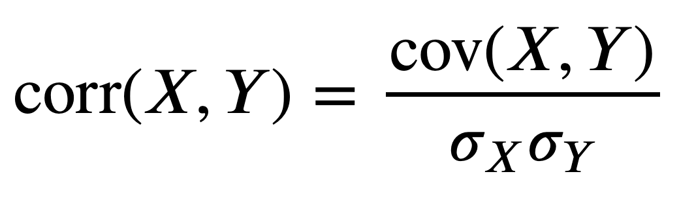
Joint Distributions
Correlation
The correlation formula is:
X

Slide 53
Joint Distributions
Correlation
It is simply the calculation for covariance divided by the product of the standard deviations of the series:
X

Slide 54
Joint Distributions
Correlation
Let’s expand this formula by showing the calculations for the standard deviations and covariance.
X

Slide 55
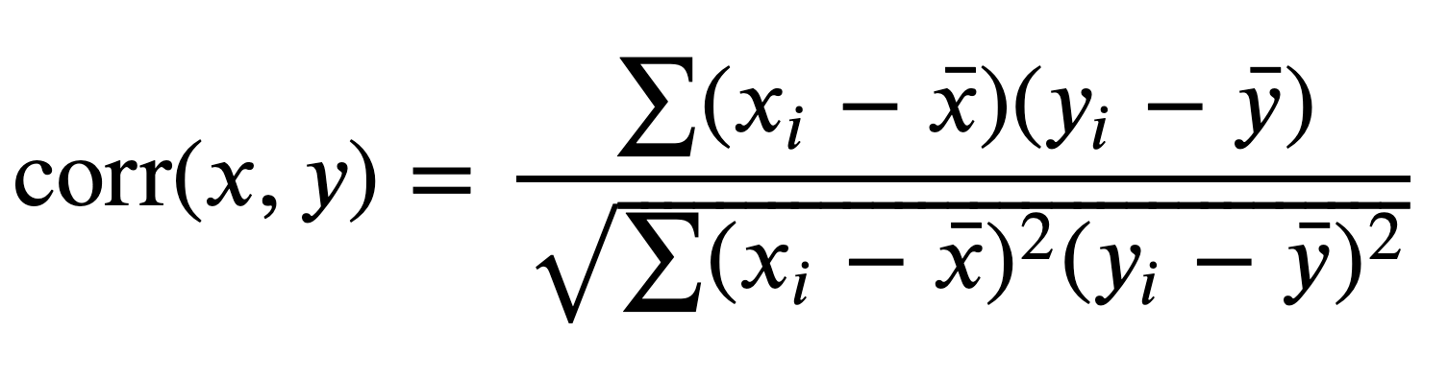
Joint Distributions
Correlation
Let’s expand this formula by showing the calculations for the standard deviations and covariance.
X

Slide 56
Joint Distributions
Correlation
Recall for covariance that x and y are separate data series, meaning they can have very different ranges of min and max values.
X

Slide 57
Joint Distributions
Correlation
Instead, it would be great to standardize the covariance so that we could always have values between -1 and 1.
X

Slide 58
Joint Distributions
Correlation
This can cause issues in trying to determine the significance of a covariance value, since it can take any value!
X

Slide 59
Joint Distributions
Correlation
The formula for correlation does this for us! It uses the denominator to standardize the covariance to be between -1 and 1.
X

Slide 60
Joint Distributions
Correlation
This makes it much easier to interpret a correlation value rather than a covariance value.
X

Slide 61
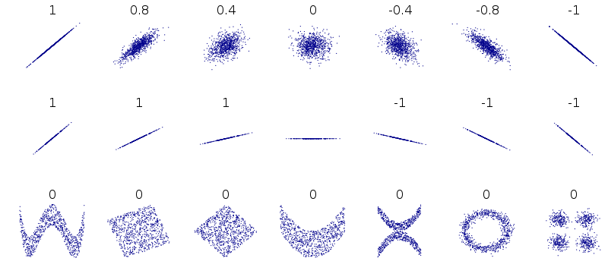
Joint Distributions
Correlation
Now you can interpret correlation regardless of the scales of X and Y!
X

Slide 62
Joint Distributions
Correlation
Notice how certain datasets with interesting behaviors can still have zero correlation value.
X

Slide 63
Joint Distributions
We now have explored covariance and correlation and understand their ability to inform us of the relationship between two data series.
You will most commonly see correlation used in organizations as the metric reported, since it is standardized to be between -1 and 1.
X

Slide 64
Joint Distributions
Let’s now take a deeper dive into covariance and correlation!
X

